Slide 1
Introduction of Machine Learning
Yu-De Chen (陳育德)
chunjoe@iir.csie.ncku.edu.tw
Orientation 108

Slide 2
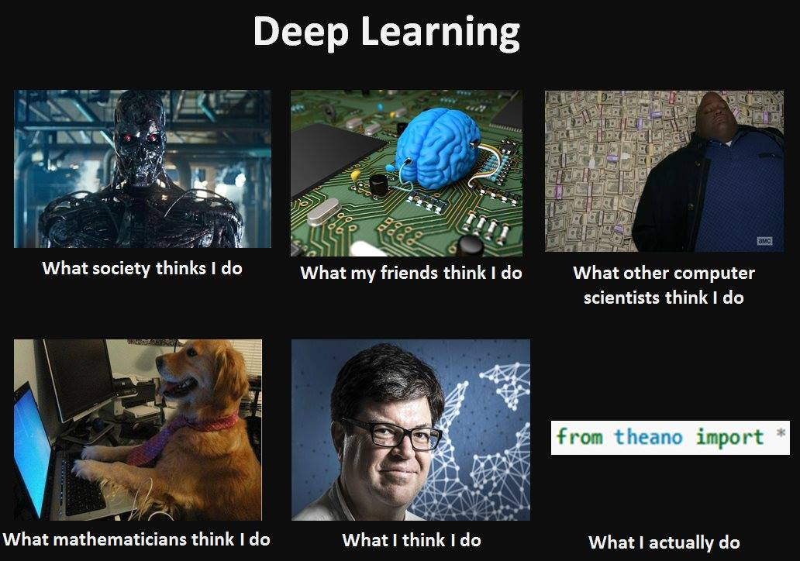

Notes:
https://medium.com/@chih.sheng.huang821/%E6%A9%9F%E5%99%A8%E5%AD%B8%E7%BF%92-%E6%94%AF%E6%92%90%E5%90%91%E9%87%8F%E6%A9%9F-support-vector-machine-svm-%E8%A9%B3%E7%B4%B0%E6%8E%A8%E5%B0%8E-c320098a3d2e

Slide 3
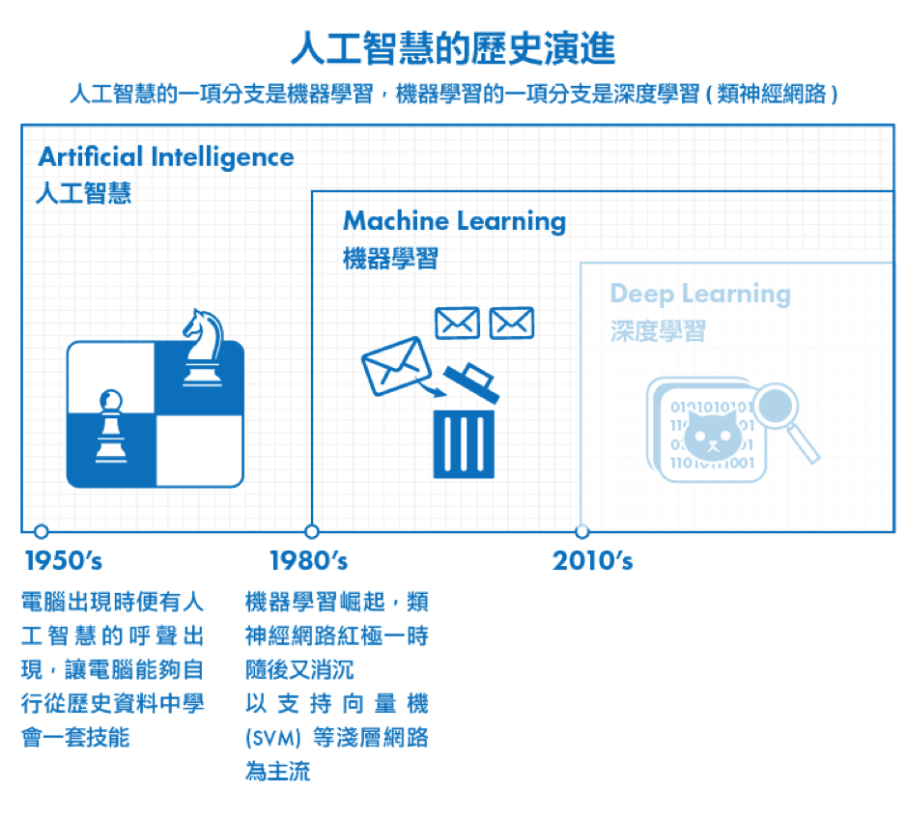
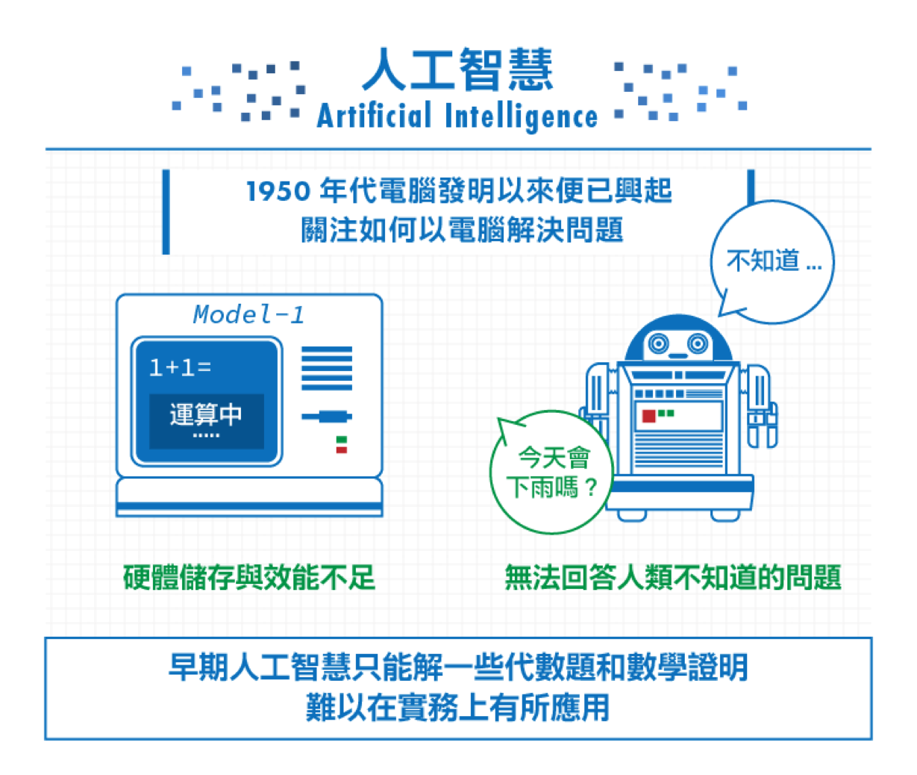
Historical evolution
John McCarthy coined the term "artificial intelligence". The field of AI research was born at a workshop at Dartmouth College in 1956.
Arthur Samuel(1995). He coined the term "machine learning" in 1959. Machine Learning: Field of study that gives computers the ability to learn without being explicitly programmed.
Notes:
http://www.cup.com.hk/2017/08/31/the-father-of-ai-john-mccarthy/
https://www.stockfeel.com.tw/機器學習的衰頹興盛：從類神經網路到淺層學習/

Slide 4

ML tasks
Notes:
https://towardsdatascience.com/machine-learning-algorithms-in-laymans-terms-part-1-d0368d769a7b

Slide 5


Slide 6
Basic steps for ML
Data Collection
Pre-processing
Training Model
Post-processing
Save Model
Discretization
Numeralization
Normalization
Stemming (text)
Feature Extraction
Dimension Reduction
Named-Entity Recognition
Handling Missing Values
Whitening
…
Model selection
Do actions according to rules made in advance

Slide 7
Data example
Notes:
https://brilliant.org/wiki/feature-vector/

Slide 8
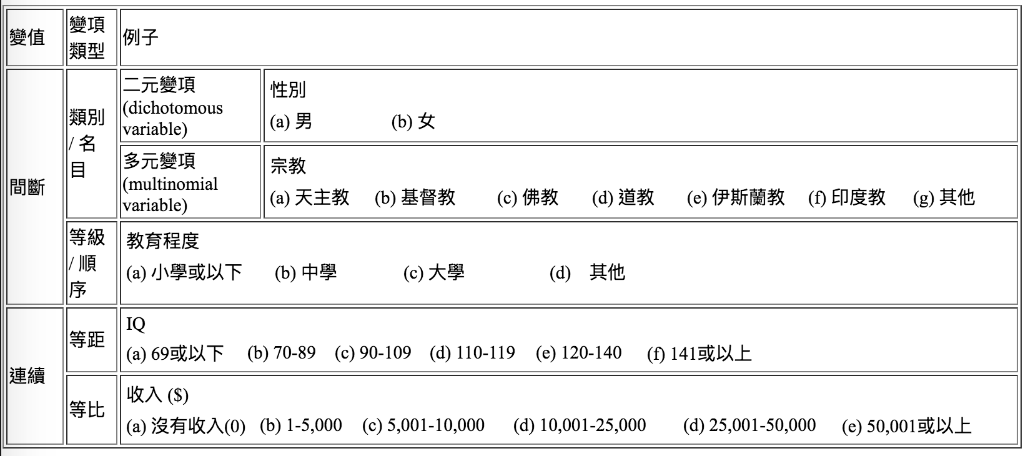
Data type
Discrete:
Category: nominal, interval, and ordinal
Continuous
Real-value: integer and float
Notes:
http://www.cuhk.edu.hk/soc/lsonline/ies/ies2009/2/electure2_1.htm

Slide 9
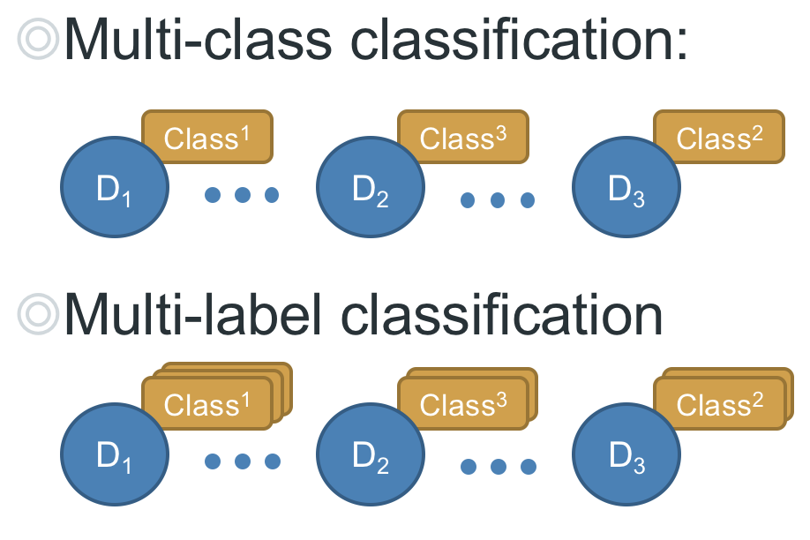
Data characteristic
Sequence data: DNA data and text
Time serial: shopping items and stock price
Pixel relationships: image data

Slide 10
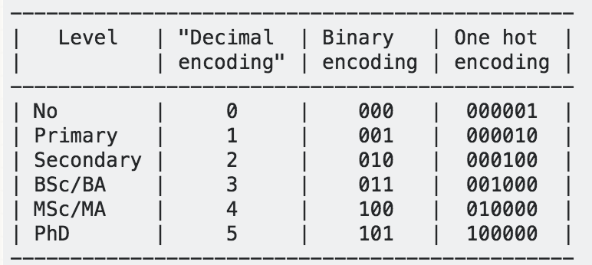
One-hot encoding
Some ML models require inputted data all are numerical. Therefore, converting data from nominal to numerical value are necessary.
Notes:
https://medium.com/@yehjames/%E8%B3%87%E6%96%99%E5%88%86%E6%9E%90-%E6%A9%9F%E5%99%A8%E5%AD%B8%E7%BF%92-%E7%AC%AC2-4%E8%AC%9B-%E8%B3%87%E6%96%99%E5%89%8D%E8%99%95%E7%90%86-missing-data-one-hot-encoding-feature-scaling-3b70a7839b4a
https://stats.stackexchange.com/questions/325263/binary-encoding-vs-one-hot-encoding

Slide 11
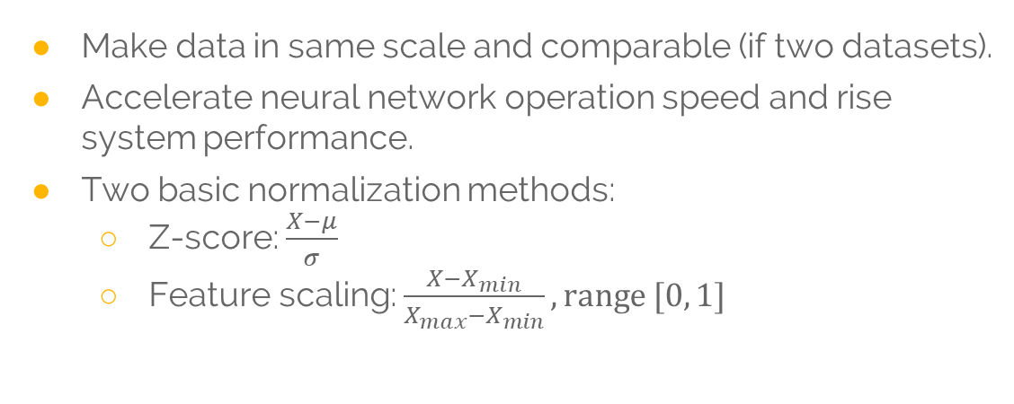
Normalization
Make data in same scale and comparable (if two datasets).
Accelerate neural network operation speed and rise system performance.
Two basic normalization methods:
Z-score: $\frac{X−μ}{σ}$
Feature scaling: $\frac{X−X_{min}}{X_{max}−X_{min}}, range [0, 1]$
Notes:
http://d396qusza40orc.cloudfront.net/ml/recoded_videos%2F04.3-LinearRegressionWithMultipleVariables-GradientDescentInPracticeIFeatureScaling%20%5Bca6f4929%5D%20.mp4

Slide 12
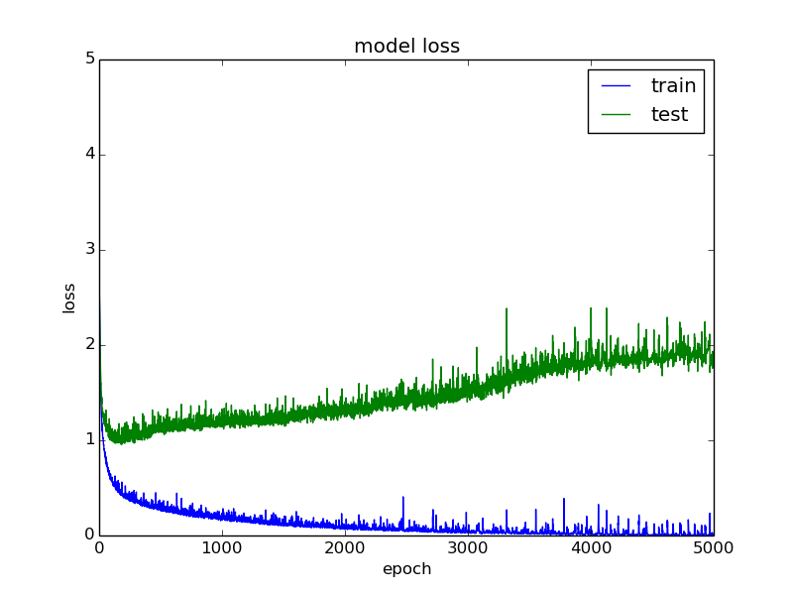
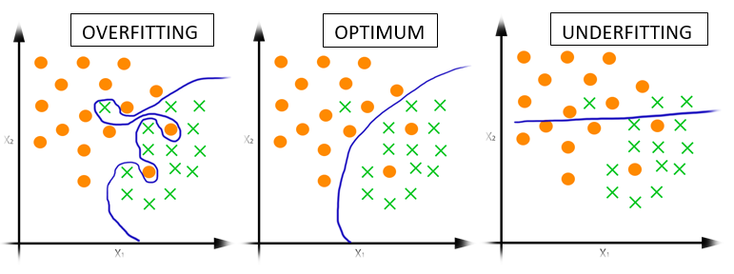
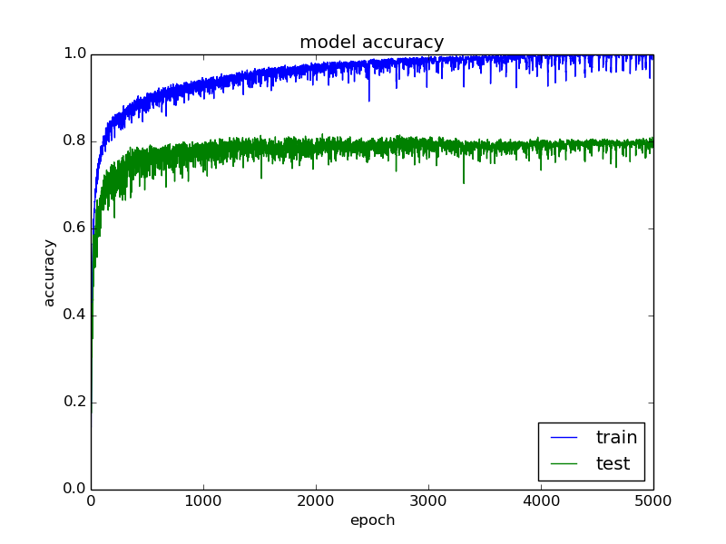
Over- & under-fitting
Notes:
https://medium.com/@srjoglekar246/overfitting-and-human-behavior-5186df1e7d19

Slide 13
Curse of dimensionality
10 training instances and with 5 unit intervals :
1D feature space: density was 10/5=2 samples/interval
2D: 10/25 = 0.4
3D: 10/125 = 0.08
Notes:
https://zhuanlan.zhihu.com/p/23471291
https://www.datasciencecentral.com/profiles/blogs/about-the-curse-of-dimensionality

Slide 14
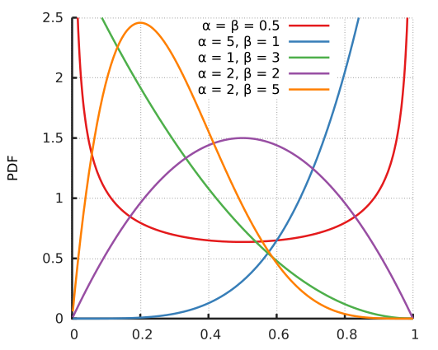
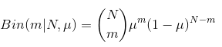
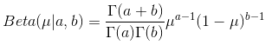
Hyperparameter
In machine learning, a hyperparameter is a parameter whose value is set before the learning process begins.
Beta Distribution
Notes:
https://en.wikipedia.org/wiki/Hyperparameter_(machine_learning)
****https://blog.csdn.net/baimafujinji/article/details/51374202
https://ithelp.ithome.com.tw/articles/10192813

Slide 15
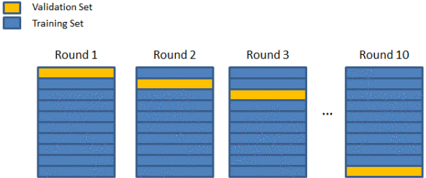
K-fold cross validation
In k-fold cross-validation, the original sample is randomly partitioned into k equal size subsamples.
The K results are again averaged (or otherwise combined) to produce a single estimation.

Slide 16
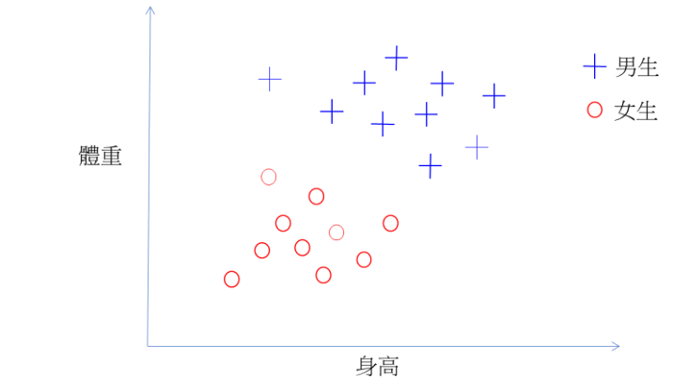
Support vector machine
Notes:
https://www.youtube.com/watch?time_continue=41&v=3liCbRZPrZA

Slide 17
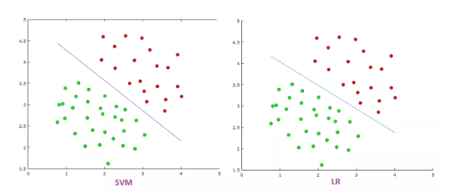
Support vector machine

Slide 18
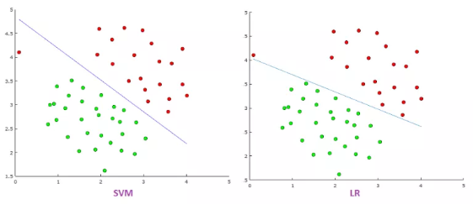
Support vector machine

Slide 19
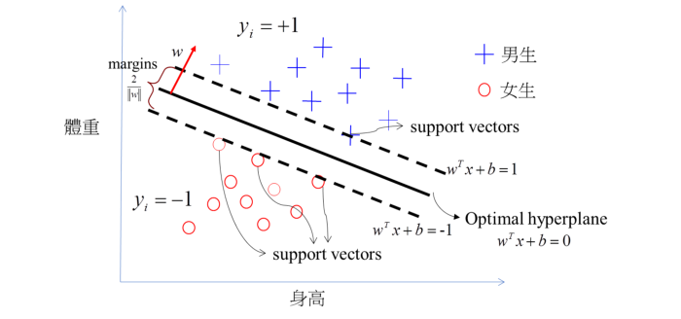
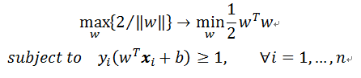
Support vector machine

Slide 20
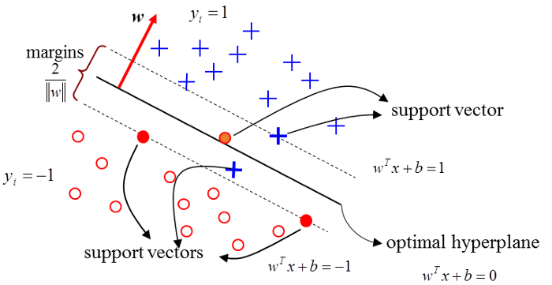
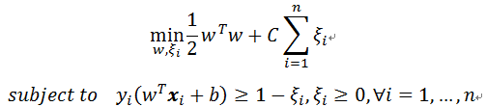
Support vector machine

Slide 21
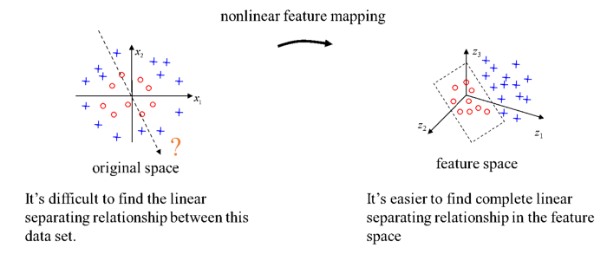
Kernel trick

Slide 22
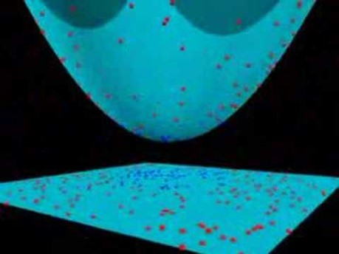
Kernel trick

